Slide 1
Yarn Prototype

Slide 2
Motivation
Limitations of the Map Reduce Model
Combining/Joining multiple datasets
Possible but not elegant
May require multiple jobs
Custom composable workflow
Requires multiple Jobs
Plumbing between Jobs is manual
Sort-Merge between M-R – Mandatory
Fault tolerance mechanisms – Rigid
Need for alternate programming models
One of the motivations for YARN
G
S
R
load customers in memory
Job boundary
LineItems
M1
Tag ‘C’
M2
M
σ
Tag ‘O’
σ
σ
M
S
S
S
S
S
S
Customers
Customers
Orders
Customers
Orders
Orders
Reduce side join
Map side join

Slide 3
The PACT programming model
Generalization of map/reduce based on Parallelization contracts [Battré et al. SoCC2010]
One second order function – “Input Contract”
Accepts a first order function F and one or more input datasets
Invokes F in data parallel fashion
F could be Map, Reduce, Match, Cross…
Optional “Output Contract”
Used to specify properties relevant to parallelization
This is a more general programming model for relational operators
Notes:
LEAVE OUT

Slide 4
Current MR vs. YARN architecture
Hadoop MapReduce
Hadoop YARN
Job Tracker (Master)
Resource management
Job lifecycle management
Scheduling, progress monitoring, fault tolerance
Task Tracker (per node)
Launch tasks
Report status to Job tracker
Resource Manager (Master)
Resource management
Scheduling
Application Master (per app)
Job lifecycle management
Node Manager (per node)
Launch Containers
Monitor resource usage
Report to RM
MapReduce itself is an Application on YARN

Slide 5
Goals
Extend the MapReduce YARN app with the following features
Ability to combine datasets – a “Combine” task * - Similar to MultipleInput contracts of PACT (eg. Match)
Ability to schedule DAGs that COMPOSE map, reduce and combine operators
Other Optimizations
Tradeoffs between fault-tolerance and performance
Turning off sort-merge when not necessary
* Different from the combiner of traditional MR that does a partial reduce
Notes:
Explicitly mention composability.
Only two points in firxt bullet – Composability and combine operator.
Optimizations: Custom radeoffs between fault-tolerance and performance.
Turning of sort-merge when not necessary.

Slide 6
Example: DAGs with “Combine”
Example: List the names of customers and the number of orders placed by them
(cust_name, o_count)
Join on cust_key
C
…
(cust_key, o_count)
R
Compute order count per cust_key (sum)
…
(cust_key, cust_name)
(cust_key, 1)
Scan customers and partition on cust_key
M
M
…
…
Scan orders and partition on cust_key with value 1
Customers.tbl
Orders.tbl
Note: For the rest of the talk, a “Node” refers to a vertex in the DAG
Notes:
TOO MUCH noise.
Leave out JSON.
For each node/phase/vertex what is it doing? BIG fonts.
Animate.

Slide 7
Extending the Task Hierarchy
MapTask - original (assumes that output goes only to reduce tasks/final output)
PolybaseMapTask
generalized – output can be connected to any node
No. of partitions is determined by the no. of instances of successor
ReduceTask - original (assumes input from map tasks only; assumes output is final)
PolybaseReduceTask
generalized – output can be connected to any node
Can pull output of any nodetype(M,R,C) and shuffle
No. of partitions is determined by the no. of instances of successor
PolybaseCombineTask

Slide 8
PolybaseCombineTask (Binary)
Accepts input from tasks of two nodes
Inputs can be M, R, or C tasks
Shuffle is identical to the one before reduce
Further, It is also used to implement replication
C
C1
C2
C3
(cust_key, …)
(cust_key, …)
M
M
p1
p2
p3
p1
p2
p3
Customers.tbl
m1
m2
…
…
Orders.tbl
m1
m2
Notes:
Show a partitioned instead of replicated case.

Slide 9
Combiner*
Accepts two <key, [value]>s ; emits <key,value> pairs
Combine(Key k1, Iterable<Value1> v1,
Key k2, Iterable<Value2> v2)
Two ways of iteration
Invoked for every pair of matching keys (k1 == k2)
Inputs are iterated over once (like sort-merge)
Invoked for every pair of k1 and k2 (cross)
Values in v2 are iterated over multiple times (like nested loops)
* Different from the combiner in MR that does a partial reduce
Notes:
Two ways of iterating: Match , or CROSS

Slide 10
Optimization: Chaining Nodes
We can now schedule DAGs of M, R, C nodes
Like MapReduce, the output of each node is materialized.
Inefficient – Materialization happens even if shuffle is unnecessary between nodes.
Such nodes are called “partition compatible”
Notes:
This and the next 3 slides:
Make the point that the scheduler you have built can now do more than MR.
Therefore you can now chain “partition compatible” nodes, i.e. nodes where the output key is identical to the input key of a successor.
Benefits – don’t have to materialize intermediates.
Chaining can be done automatically, and be implemented as an N-ary combine node.

Slide 11
Example: 3-way join on a single key
No shuffle necessary
C
C
(n_key, …)
C
(n_key, …)
(n_key, …)
(n_key, …)
M
M
M
M
M
M
Cust.tbl
Nations.tbl
Supp.tbl
Cust.tbl
Nations.tbl
Supp.tbl
If ANY consecutive nodes are partition compatible, they can be executed as one N-input node
Avoids materialization of intermediate output
Notes:
Conceptually, an N-way join is a DSQL operation.

Slide 12
PolybaseCombineTask (N-ary)
Generalize combine to take N inputs.
Combiner interface can be expressed in two equivalent ways:
As one n-way operation
Combine(Key k1, Iterable<Value1> v1, Key k2, Iterable<Value2> v2,
Key k3, Iterable<Value3> v3 ,… )
Or as a Chain of binary operations
Combine(Key k1, Iterable<Value1> v1, Key k2, Iterable<Value2> v2)
Combine(Key kc1, Iterable<Value1> vc1, Key k3, Iterable<Value3> v3)
…
Inputs could be partitioned/replicated
Generalizes the reducer (1 input combiner)

Slide 13
Example: Adapted from TPCH Query 3
SELECT L_ORDERKEY, O_ORDERDATE, O_SHIPPRIORITY
SUM(L_EXTENDEDPRICE*(1-L_DISCOUNT)) AS REVENUE,
FROM CUSTOMER, ORDERS, LINEITEM
WHERE C_MKTSEGMENT = 'BUILDING'
AND C_CUSTKEY = O_CUSTKEY
AND L_ORDERKEY = O_ORDERKEY
GROUP BY L_ORDERKEY, O_ORDERDATE, O_SHIPPRIORITY

Slide 14
Example: DAG
(o_key, o_date, ship_priority, sum(price *(1 – discount))
C
(o_key|o_date|ship_priority, price, discount)
C
o_key
(order_key, …)
C
cust_key
(cust_key, ..)
(cust_key, …)
(order_key, price, discount)
M
M
M
Customers.tbl
Orders.tbl
LineItems.tbl

Slide 15
DAG Specification
{ "1": { "type": "MAP",
"input": "/tpch/customer.tbl",
"operator": "org.pbase.PolybaseDAGs$CustomerIDMapper“ } ,
"2": { "type": "MAP",
"input": "/tpch/orders.tbl",
"operator":"org.pbase.PolybaseDAGs$OrderCustIDMapper” } ,
“3": { "type": "COMBINE",
"operator": "org.pbase.PolybaseDAGs$CustOrderInnerJoin", "inputs": ["1", "2"],
"qty": 3 } ,

Slide 16
DAG Specification contd.
“4": { "type": "MAP",
"input": "/tpch/lineitem.tbl",
"operator": "org.pbase.PolybaseDAGs$LineItemOrderIDMapper“ } ,
"5": { "type": "COMBINE",
"operator": "org.pbase.PolybaseDAGs$COLineItemInnerJoin", "inputs": [“3", “4"],
"qty": 3 } ,
"6": { "type": "COMBINE",
"operator": "org.pbase.PolybaseDAGs$FinalAggregator",
"inputs": ["5"],
"qty": 3 }
}

Slide 17
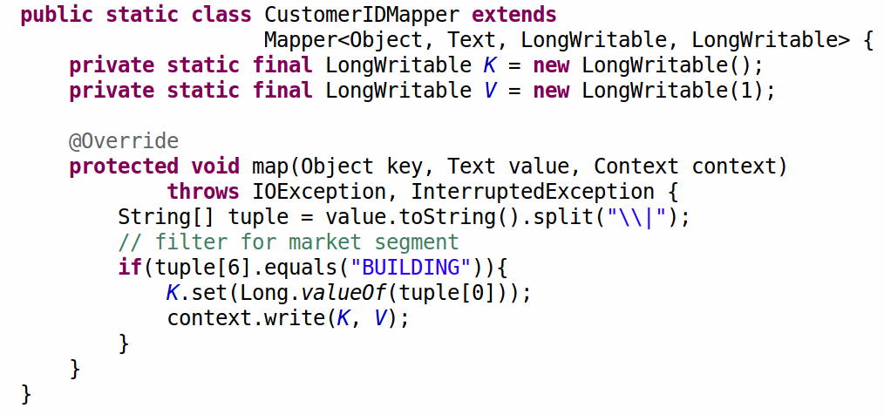
Mapper

Slide 18
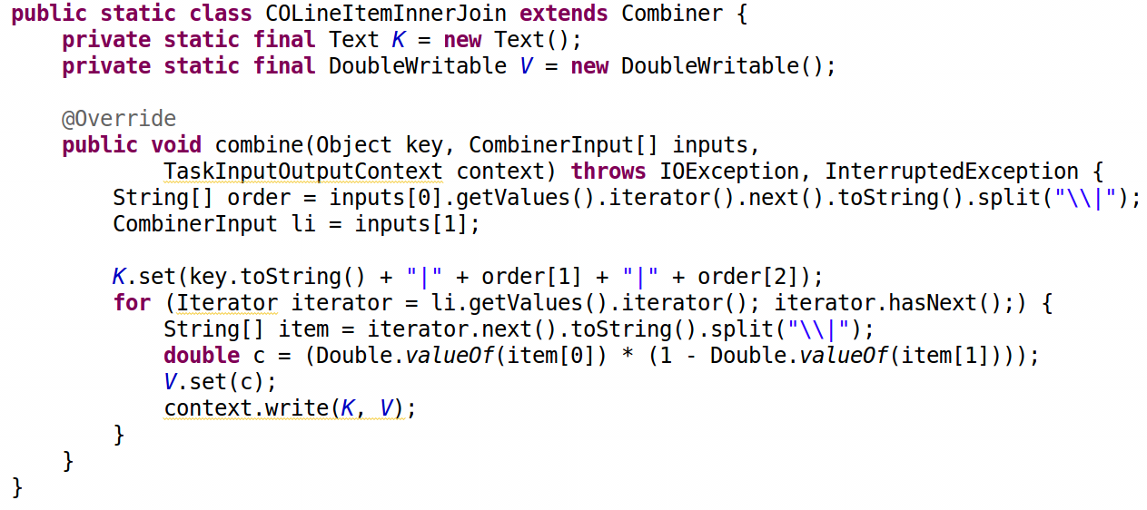
2-Way Combiner
CombinerInput
combine( Key k1, Iterable<Value1> v1, Key k2, Iterable<Value2> v2,
Key k3, Iterable<Value3> v3 ,… )

Slide 19
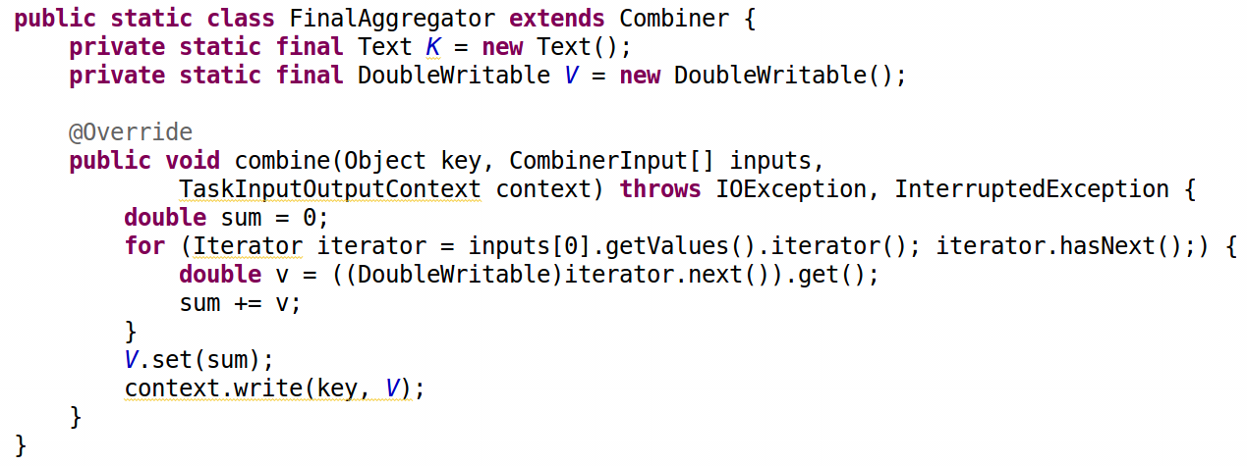
1-Way Combiner (Reducer)

Slide 20
Optimization
Tradeoff between fault-tolerance and performance/utilization
Fetch uncommitted output
Relaxing the ‘Reducer contract’ for combiners
Turning off sort-merge if not necessary
Notes:
Ongoing WORK.
Tradeoff between fault tolerance and performance/utilization.

Slide 21
Fault Tolerance vs. performance/utilization
Current state
Only after a task completes successfully, it’s output is fetched by the consumer
If a task output is lost, ONLY that task needs to be re-run
Optimization – Fetch uncommitted output
Overlap task execution with successor fetch
COULD improve performance/utilization (experiments in progress)
If a task fails, invalidate and restart successor fetch too – more work.
Fault tolerance boundary spans multiple nodes

Slide 22
Relaxing the Reducer/Combiner input contract
Current state
Map outputs are sorted and merged
Reduce is invoked with values grouped by key
Optimization - Relax the sort-merge assumption
Some combine implementations don’t need sorted, grouped inputs (eg. Hash based joins, group bys)
Partitioning of inputs across tasks is retained, Sort is turned off
Relaxed Combine contract
Combine(Iterable<K1, V1> i1, Iterable<K2, V2> i2, Iterable<K3, V3> i3 ,… )

Slide 23
Putting it together
Consuming uncommitted output
Fetch overlapped with predecessor execution
Disabling Sort
Task execution overlapped with fetch from predecessor
Spills (unsorted, partitioned)
m1
M
M1 starts producing unsorted, partitioned spills
C1 and C2 start pulling these spills into their queues
C1 and C2 start consuming while M1 is still producing
…
S3
S2
S1
queue
C1
C2
C

Slide 24
Chaining Combines
If a series of 2-way combines are partition compatible, they can be executed as one one JobNode
No data movement operation necessary between them
Conditions:
Inputs to all the combine nodes should have the same key
All combine nodes should have same no. of tasks
Holds true not only for Combine
(nation_key, n_name, c_count, s_count)
C
(nation_key, n_name, c_count)
C
(nation_key, 1)
(nation_key, …)
(nation_key, 1)
M
M
M
Customers.tbl
Nations.tbl
Suppliers.tbl
Notes:
Mention DSQL Operation.

Slide 25
1. Fetch uncommitted output
Node can pull sorted spills from a running predecessor and merge
Overlaps data transfer with computation
Events raised for every spill generated
However,
May increase load on the node manager where spills reside
Will have to be discarded if predecessor fails
M
m1
sorted spills
…
S3
S2
S1
merge
C1
C2
C

Slide 26
2. Turning off Sort-Merge
Producer:
Maintain output buffers per partition
Perform spill (unsorted) per partition
Concatenate partitions at the end
Consumer
No need to merge inputs from different tasks
Directly invoke combiner with <key, value> pairs

Slide 27
Yarn MR Lifecycle
Resource Manager
MRAppMaster
Node Manager
YarnChild (task)
Client
submit
spawn
poll
MR rsrc request
updates
. . . .
allocated containers
scheduleMRTasks
M R
spawn
. . . .
taskCompleted
. . . .
rsrc release request
. . . .
complete
jobCompleted
Process/node boundary

Slide 28
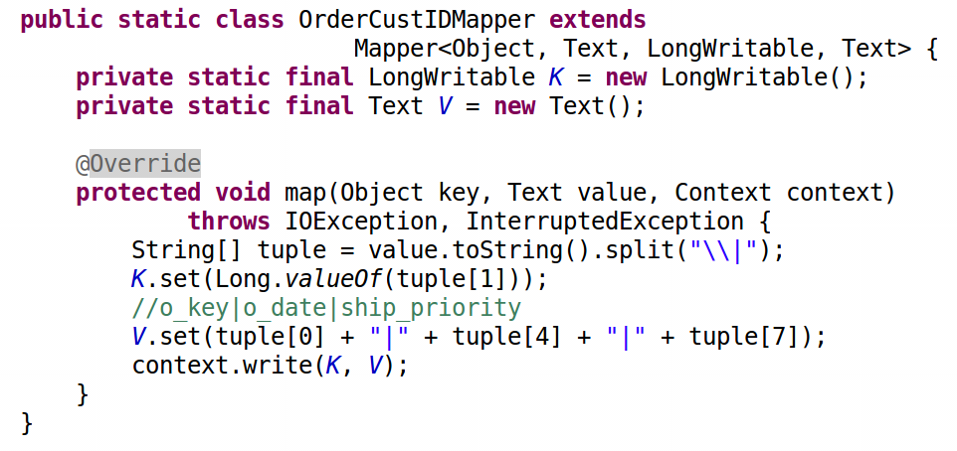

Slide 29
